Slide 1

Mountain Medical Team
Second Meeting

Slide 2

Team Member Introductions
Did anyone new join the team since the last meeting?

Slide 3
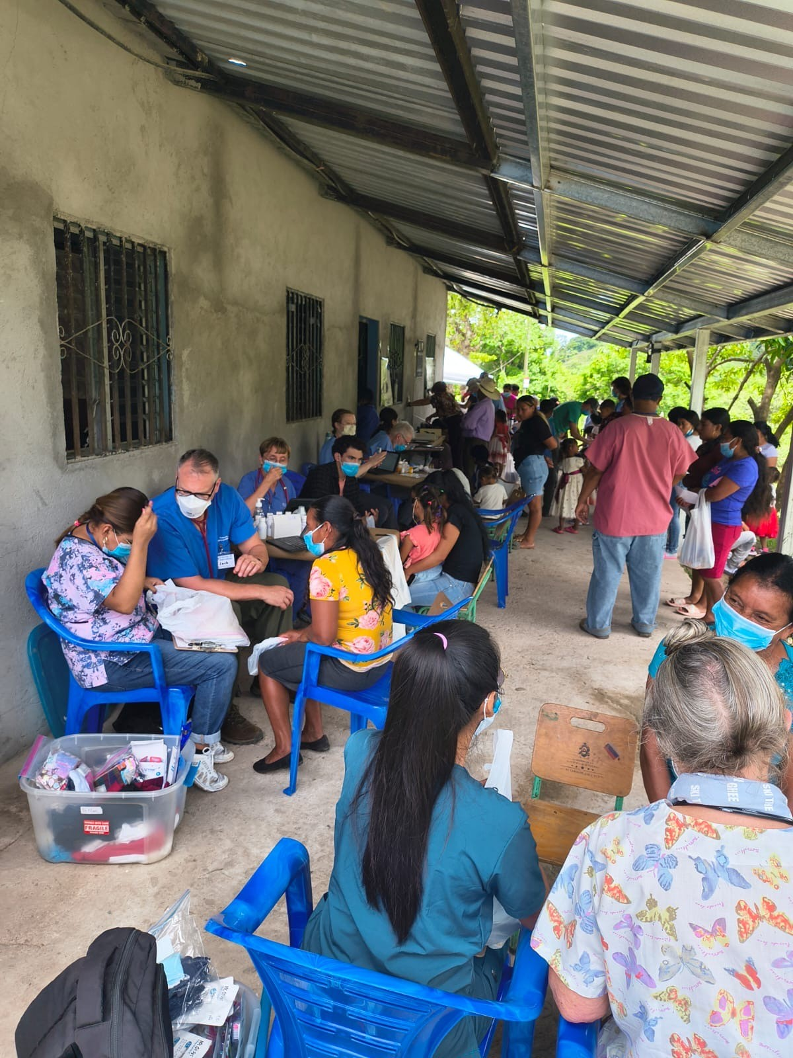
Preparing for our Roles in Clinic
Who is working where?
4-6 Medical Volunteers
7-8 Non-medical Volunteers
  1-2 Translators
  1 in Weights & Measures
  1 taking Blood Pressures
  1 in Vitamins & De-worming
  1 in Pharmacy
  2 in Dental
Detailed instructions for each station can be found at www.fobf.org/training

Slide 4
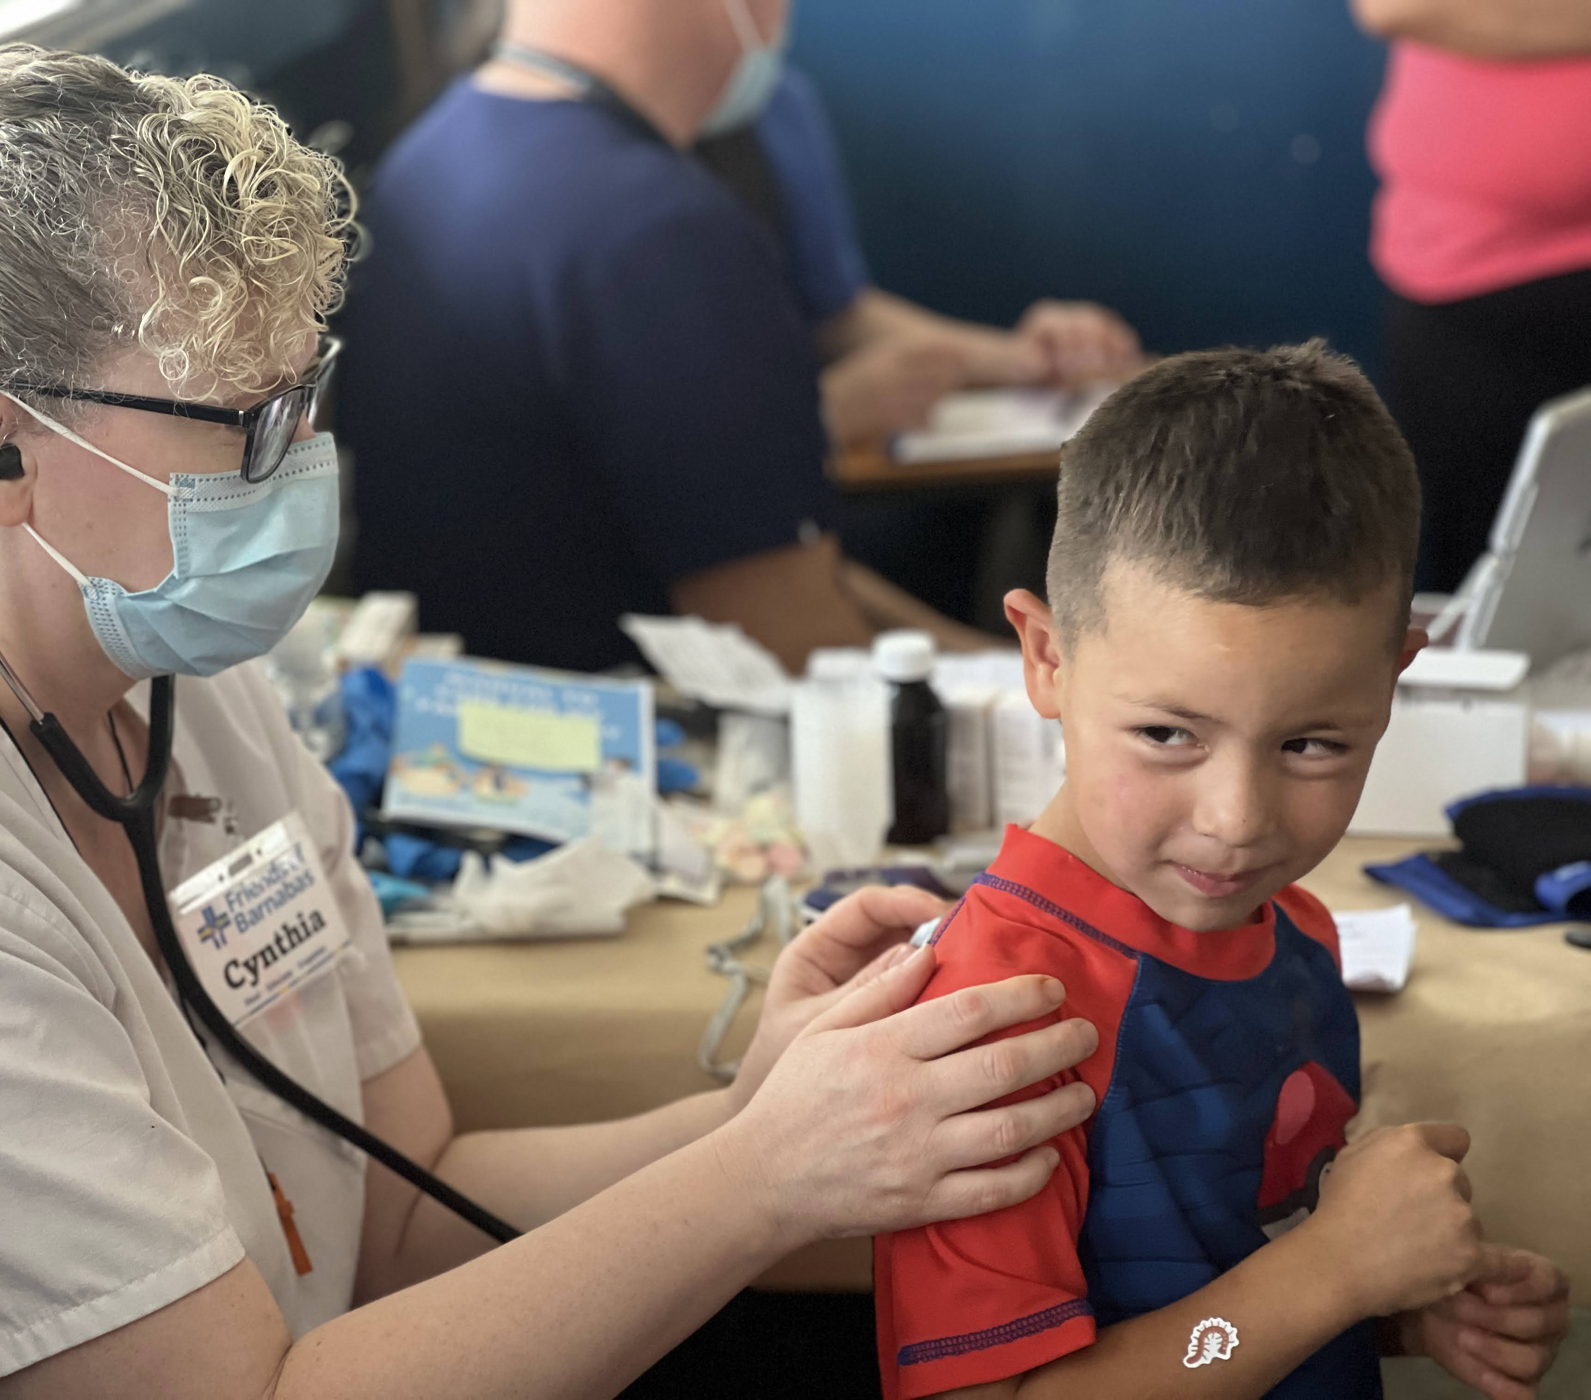
Medical Volunteers
A Medical Manual will be provided to you with complete instructions, and Jo Ellen Nutter, FOB’s Medical Director, will hold a training for all medical volunteers on your team prior to departure.
Wellness bags will be at each medical station for distribution to families. Bags contain:
    Acetaminophen
    Antacids
    Antibacterial Cream
    Hydrocortisone Cream
    Toothbrushes & Powder
    Educational Sheet

Slide 5
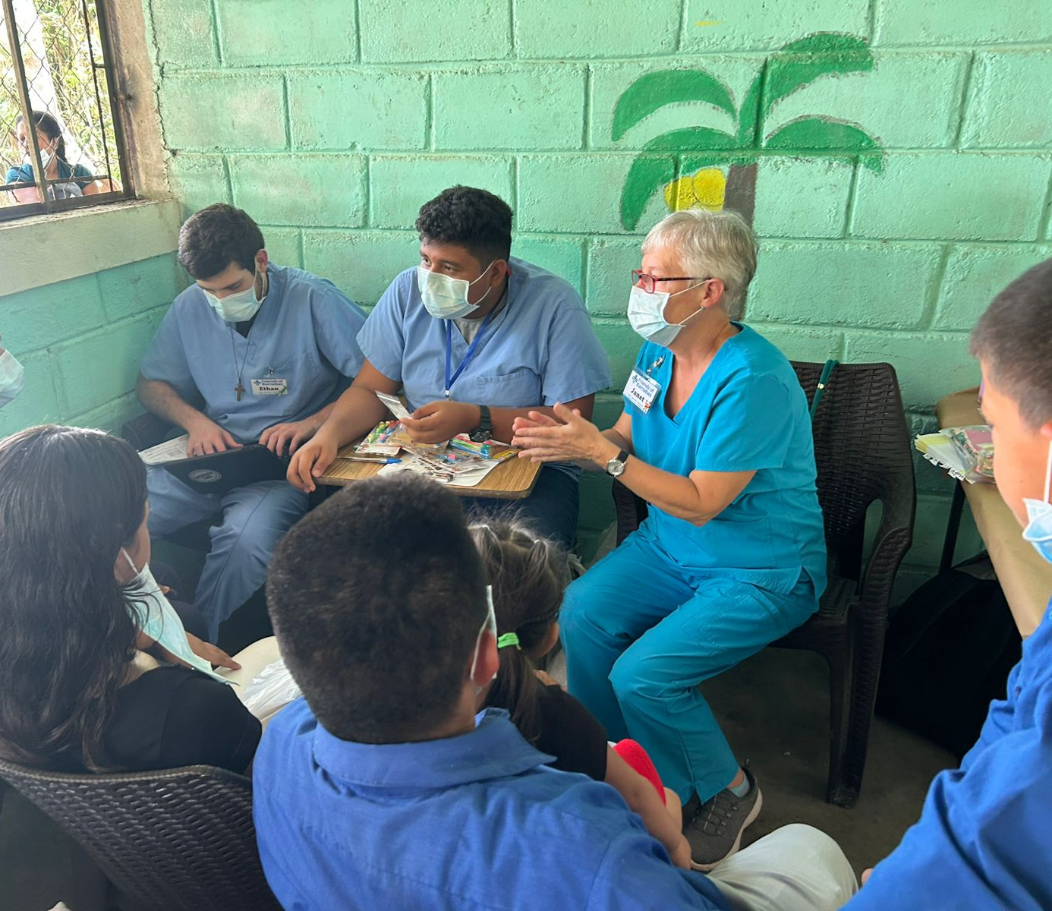
Translators
FOB hires local translators, but volunteers who are fluent may fill this role.
Translators will be assigned to clinic areas as needed.
Please review medical terms in Spanish
Please join the EMR training on Sunday before clinics start.

Slide 6
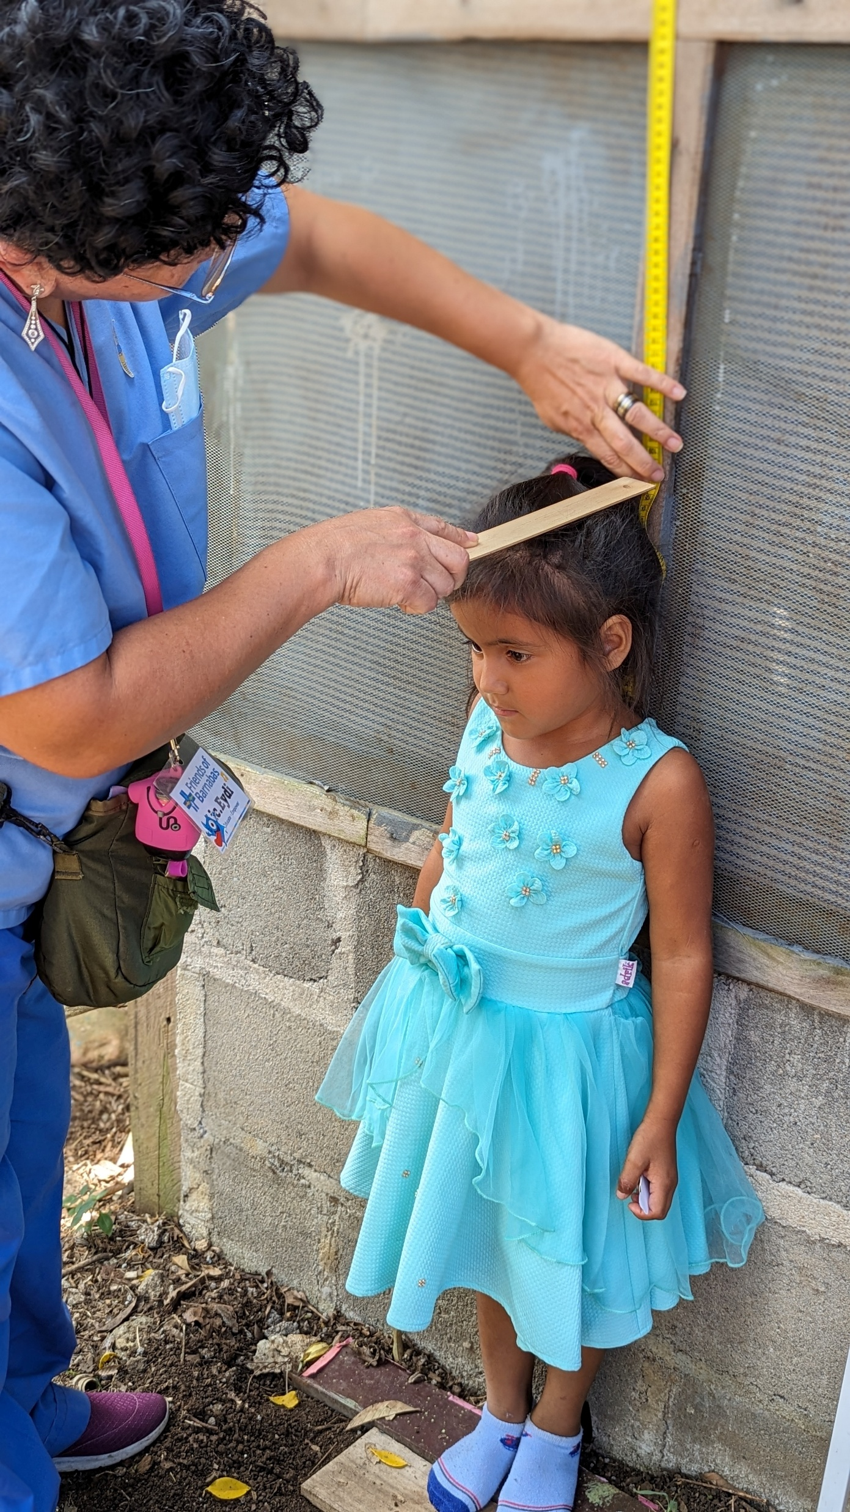
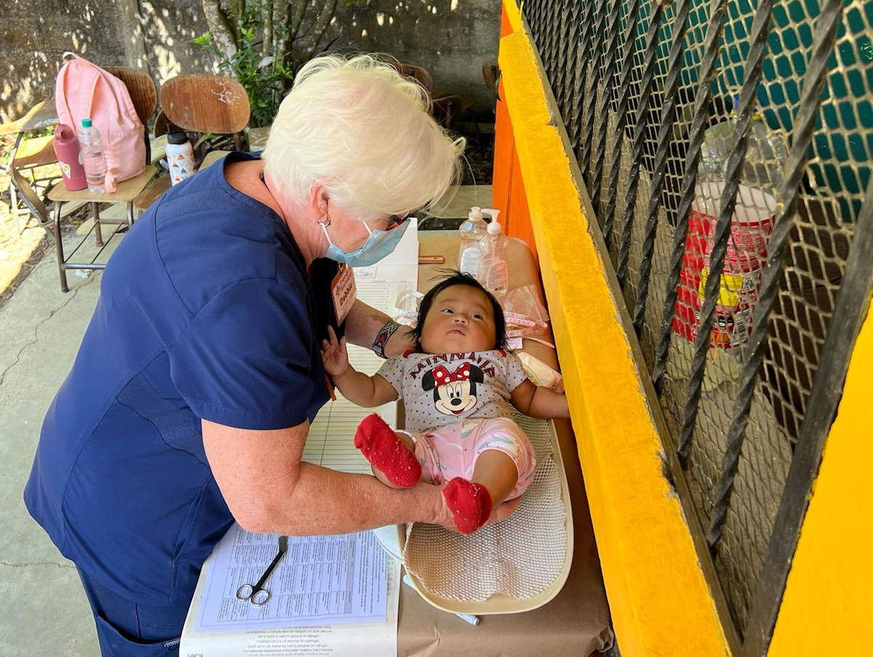
Weights & Measures
Weight, height and head circumference is taken for each child under 3 years old.
Weight and height is taken for 3–12-year-olds.

Slide 7
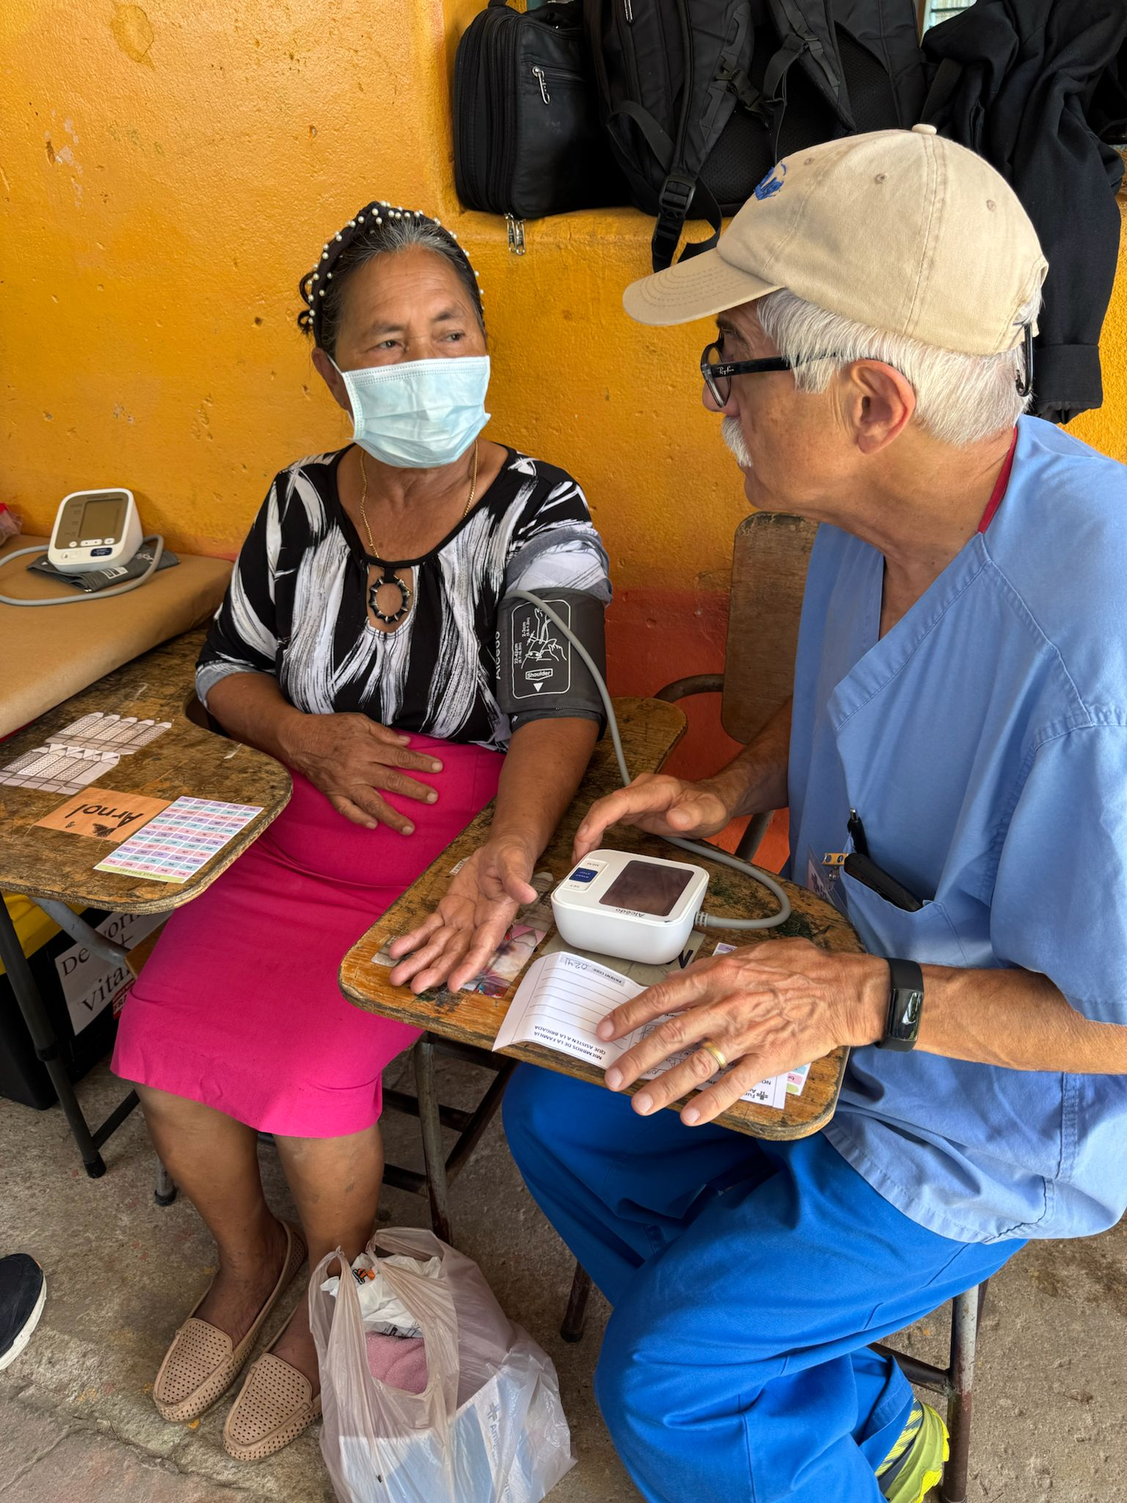
Blood Pressure
All patients over 30 years old and all pregnant women will have their blood pressure taken before they go to the medical station.

Slide 8
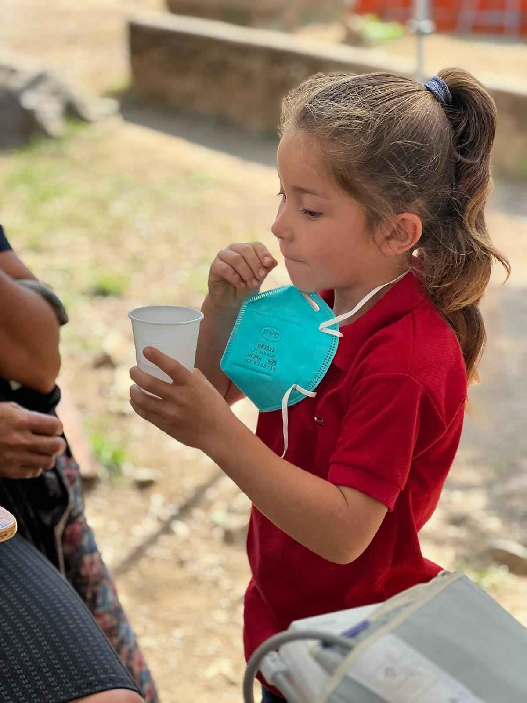
Vitamins & Deworming
Anti-parasite medication is given to family members who need it. It is one chewable tablet, given with a cup of water to wash it down.
Vitamins are given to families based on their family composition:
  Adult vitamins
  Children’s chewable vitamins
  Children’s liquid vitamins
  Infant vitamins
  Pre-natal vitamins

Slide 9
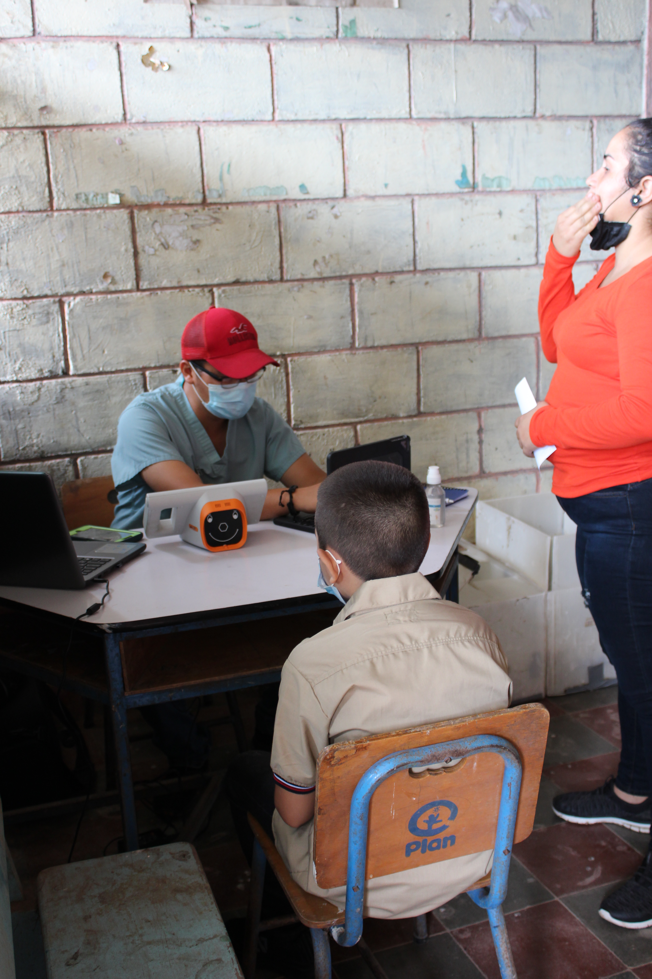
Vision Clinics
  An adult and child vision station are run by Honduran staff, but at times we may need a volunteer to assist in this clinic.

Slide 10
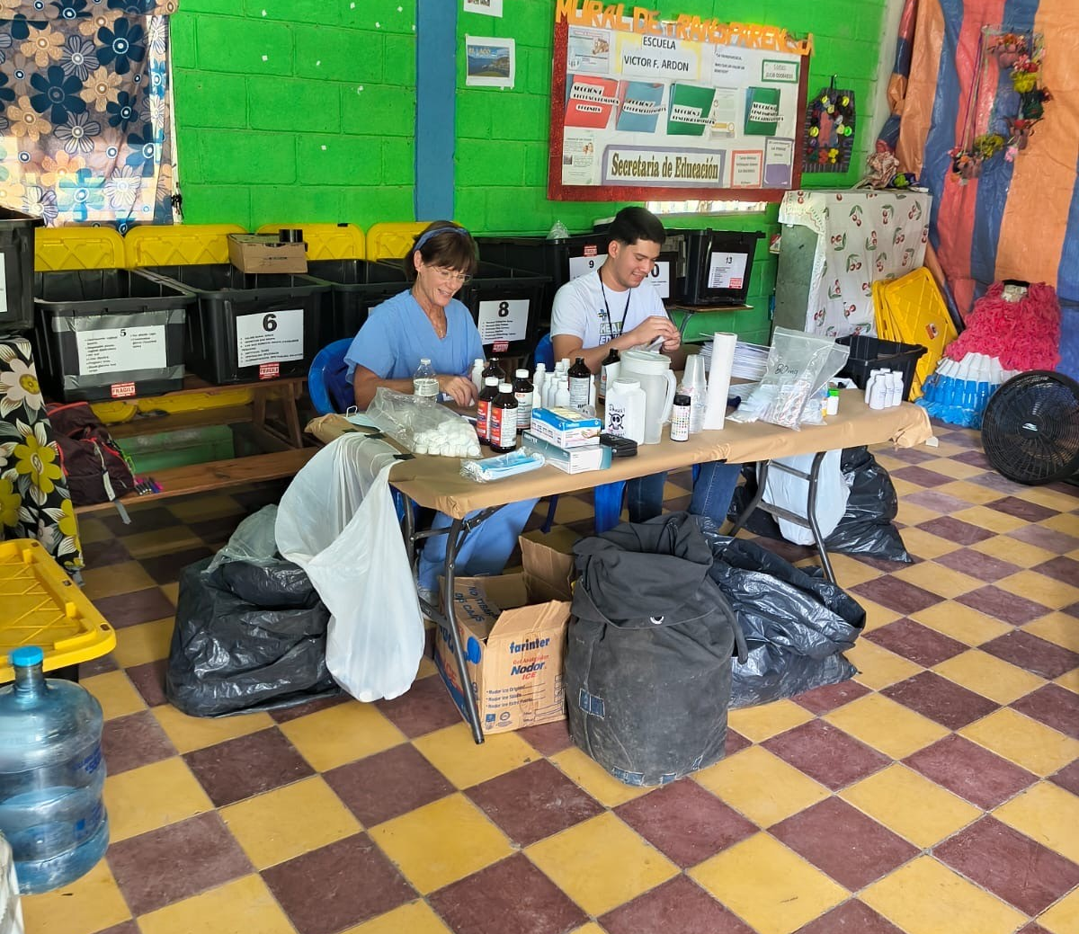
Pharmacy
This team member will work with a Honduran staff member to pack and deliver medications requested by medical providers.

Slide 11
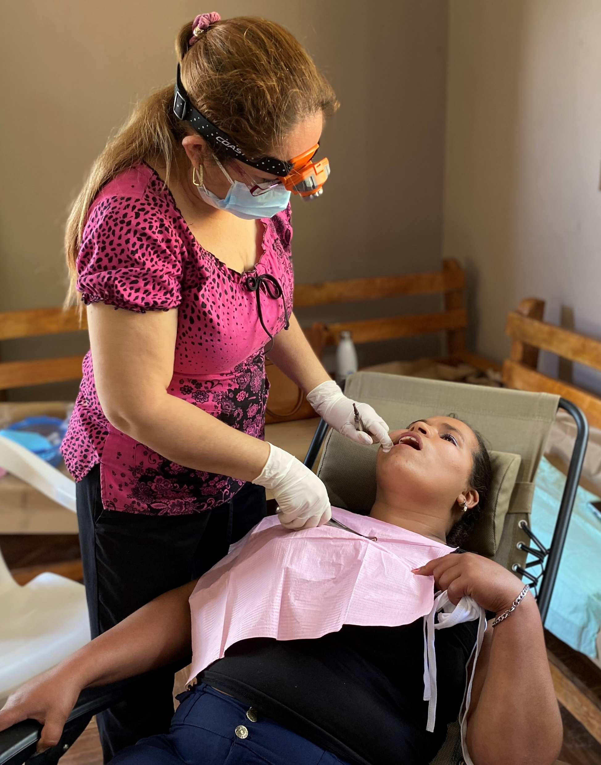
Dental Clinic
Dental patients will be seen in the dental clinic after they have been to all other clinic areas.
One volunteer will assist Dra. Ondina & Dra. Jeimy with cleaning instruments and documenting procedures in the EMR
One volunteer with will apply fluoride treatments.

Slide 12



Team Support Roles -
Can I get Some Volunteers???
Medical Team Leader
Journal Keeper
Devotion Coordinator
Instructions for these roles can be found at www.fobf.org/training

Slide 13
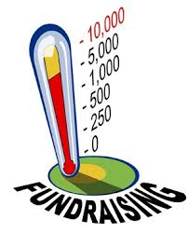
Fundraising Updates

Slide 14
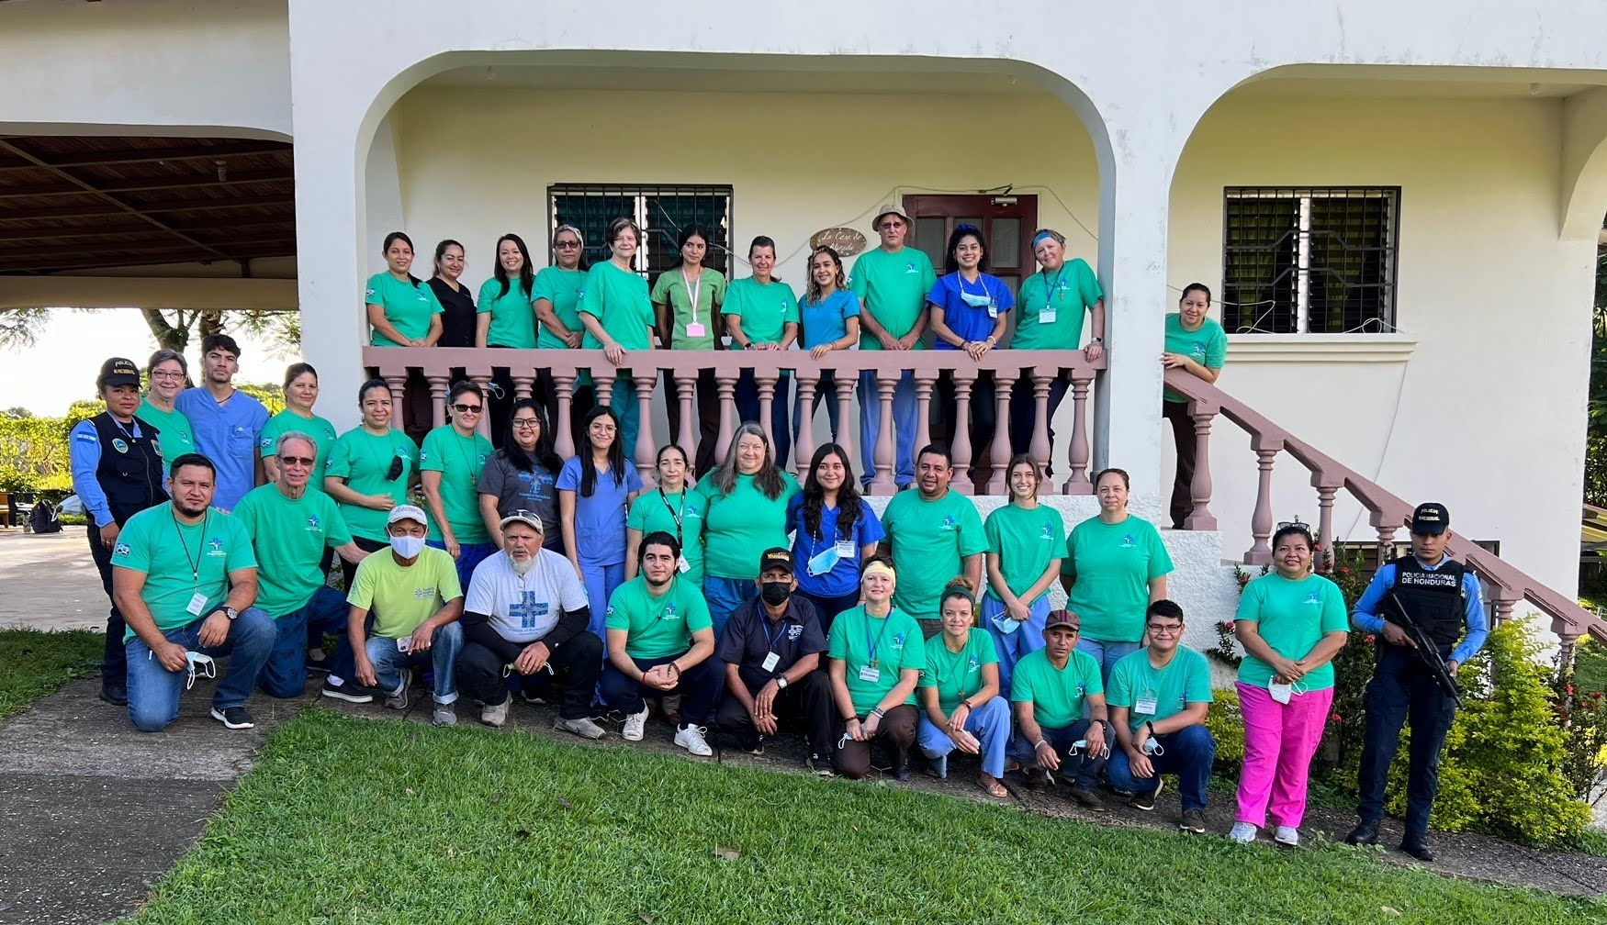
Things we Will Cover in our Next Meeting
Cultural Sensitivity
Gift Giving Policy
Safety Policies
Packing
Fundraising Check-in
Reminders:
  WhatsApp
  Register with Embassy
  Customs Form
What Questions Do You Have?

