Slide 1

Mountain Medical Team 3rd Meeting

Slide 2

Team Member Introductions
Did anyone new join the team since the last meeting?

Slide 3
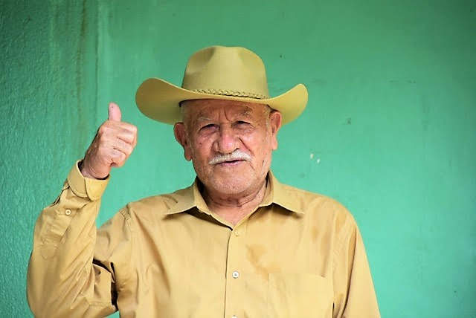
Cultural Sensitivity
How we tell the story- we are partnering with communities as opposed to rescuing them.
We are guests at Alfredo’s House and we are guests in the communities. Be respectful.
We have much to learn while in Honduras.

Slide 4
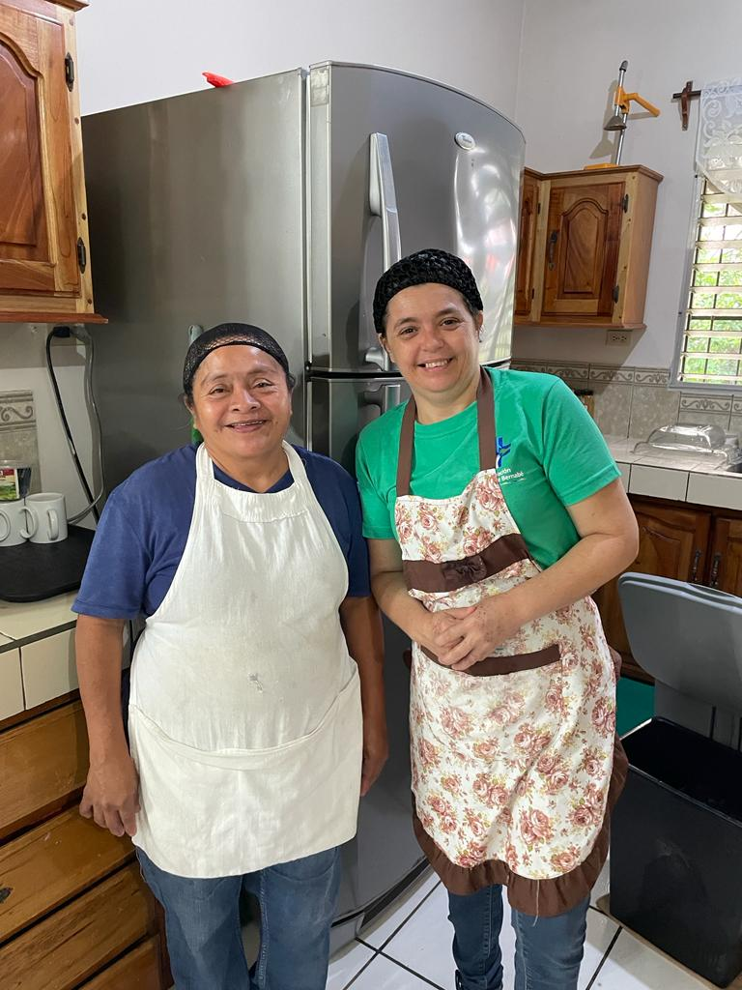
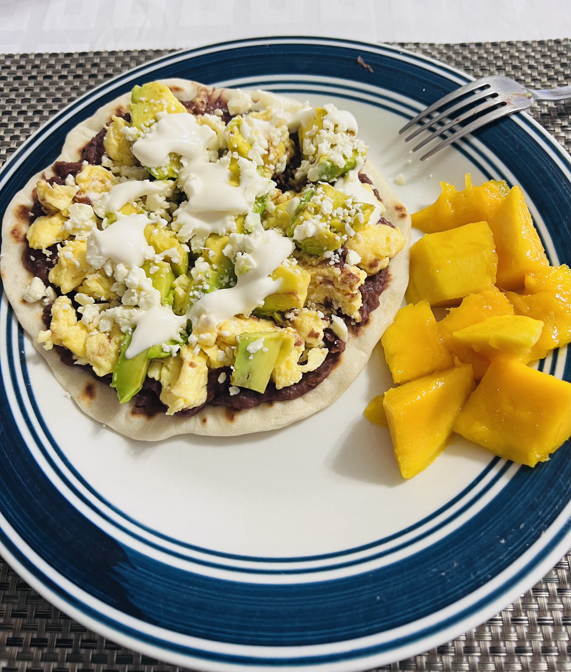
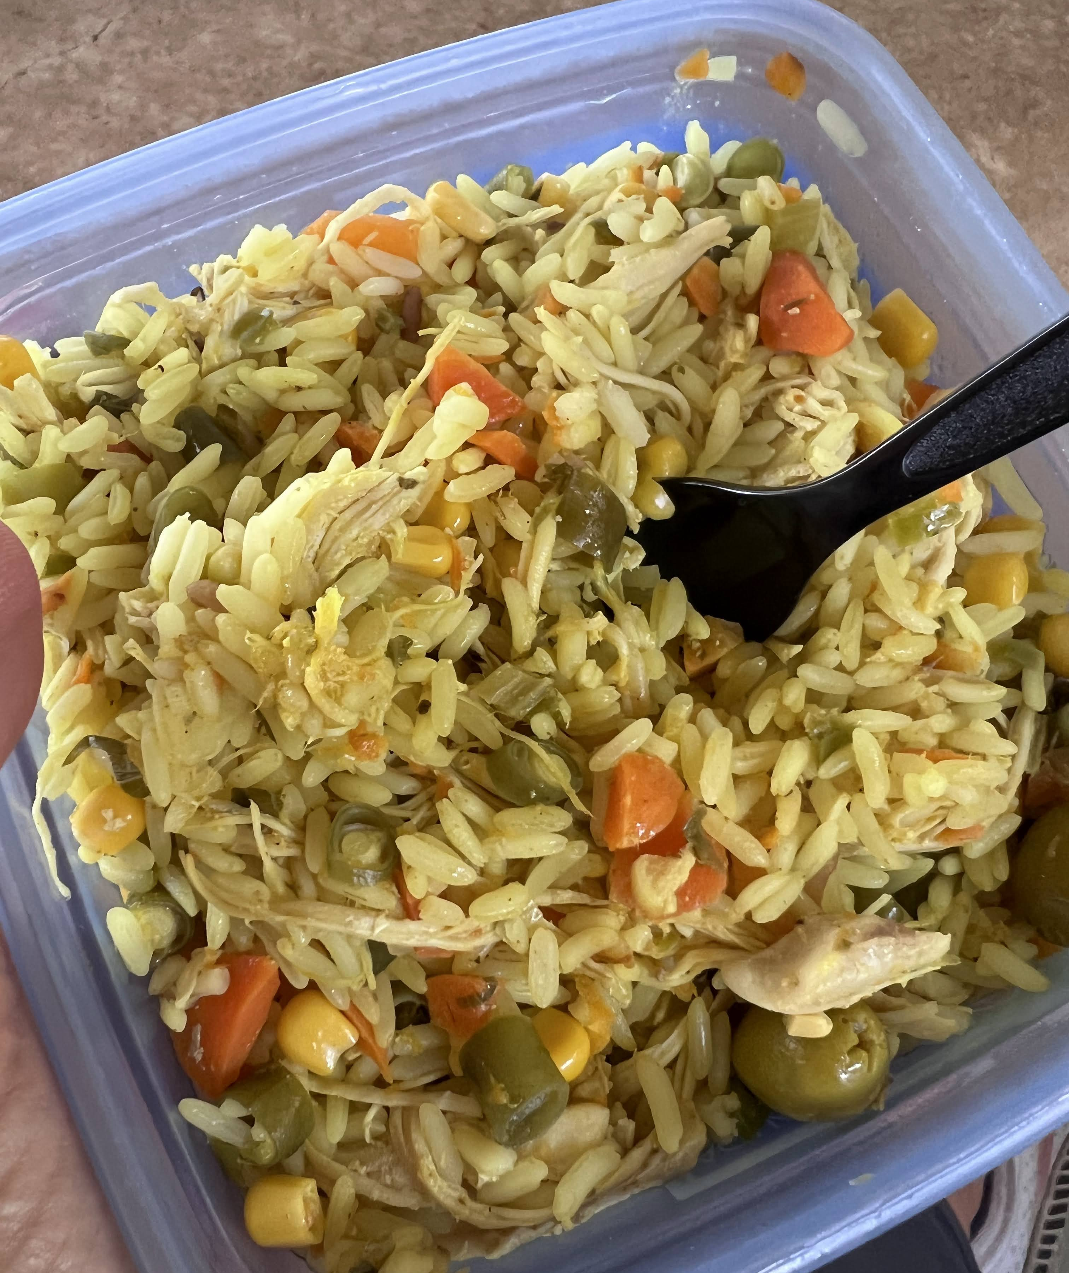
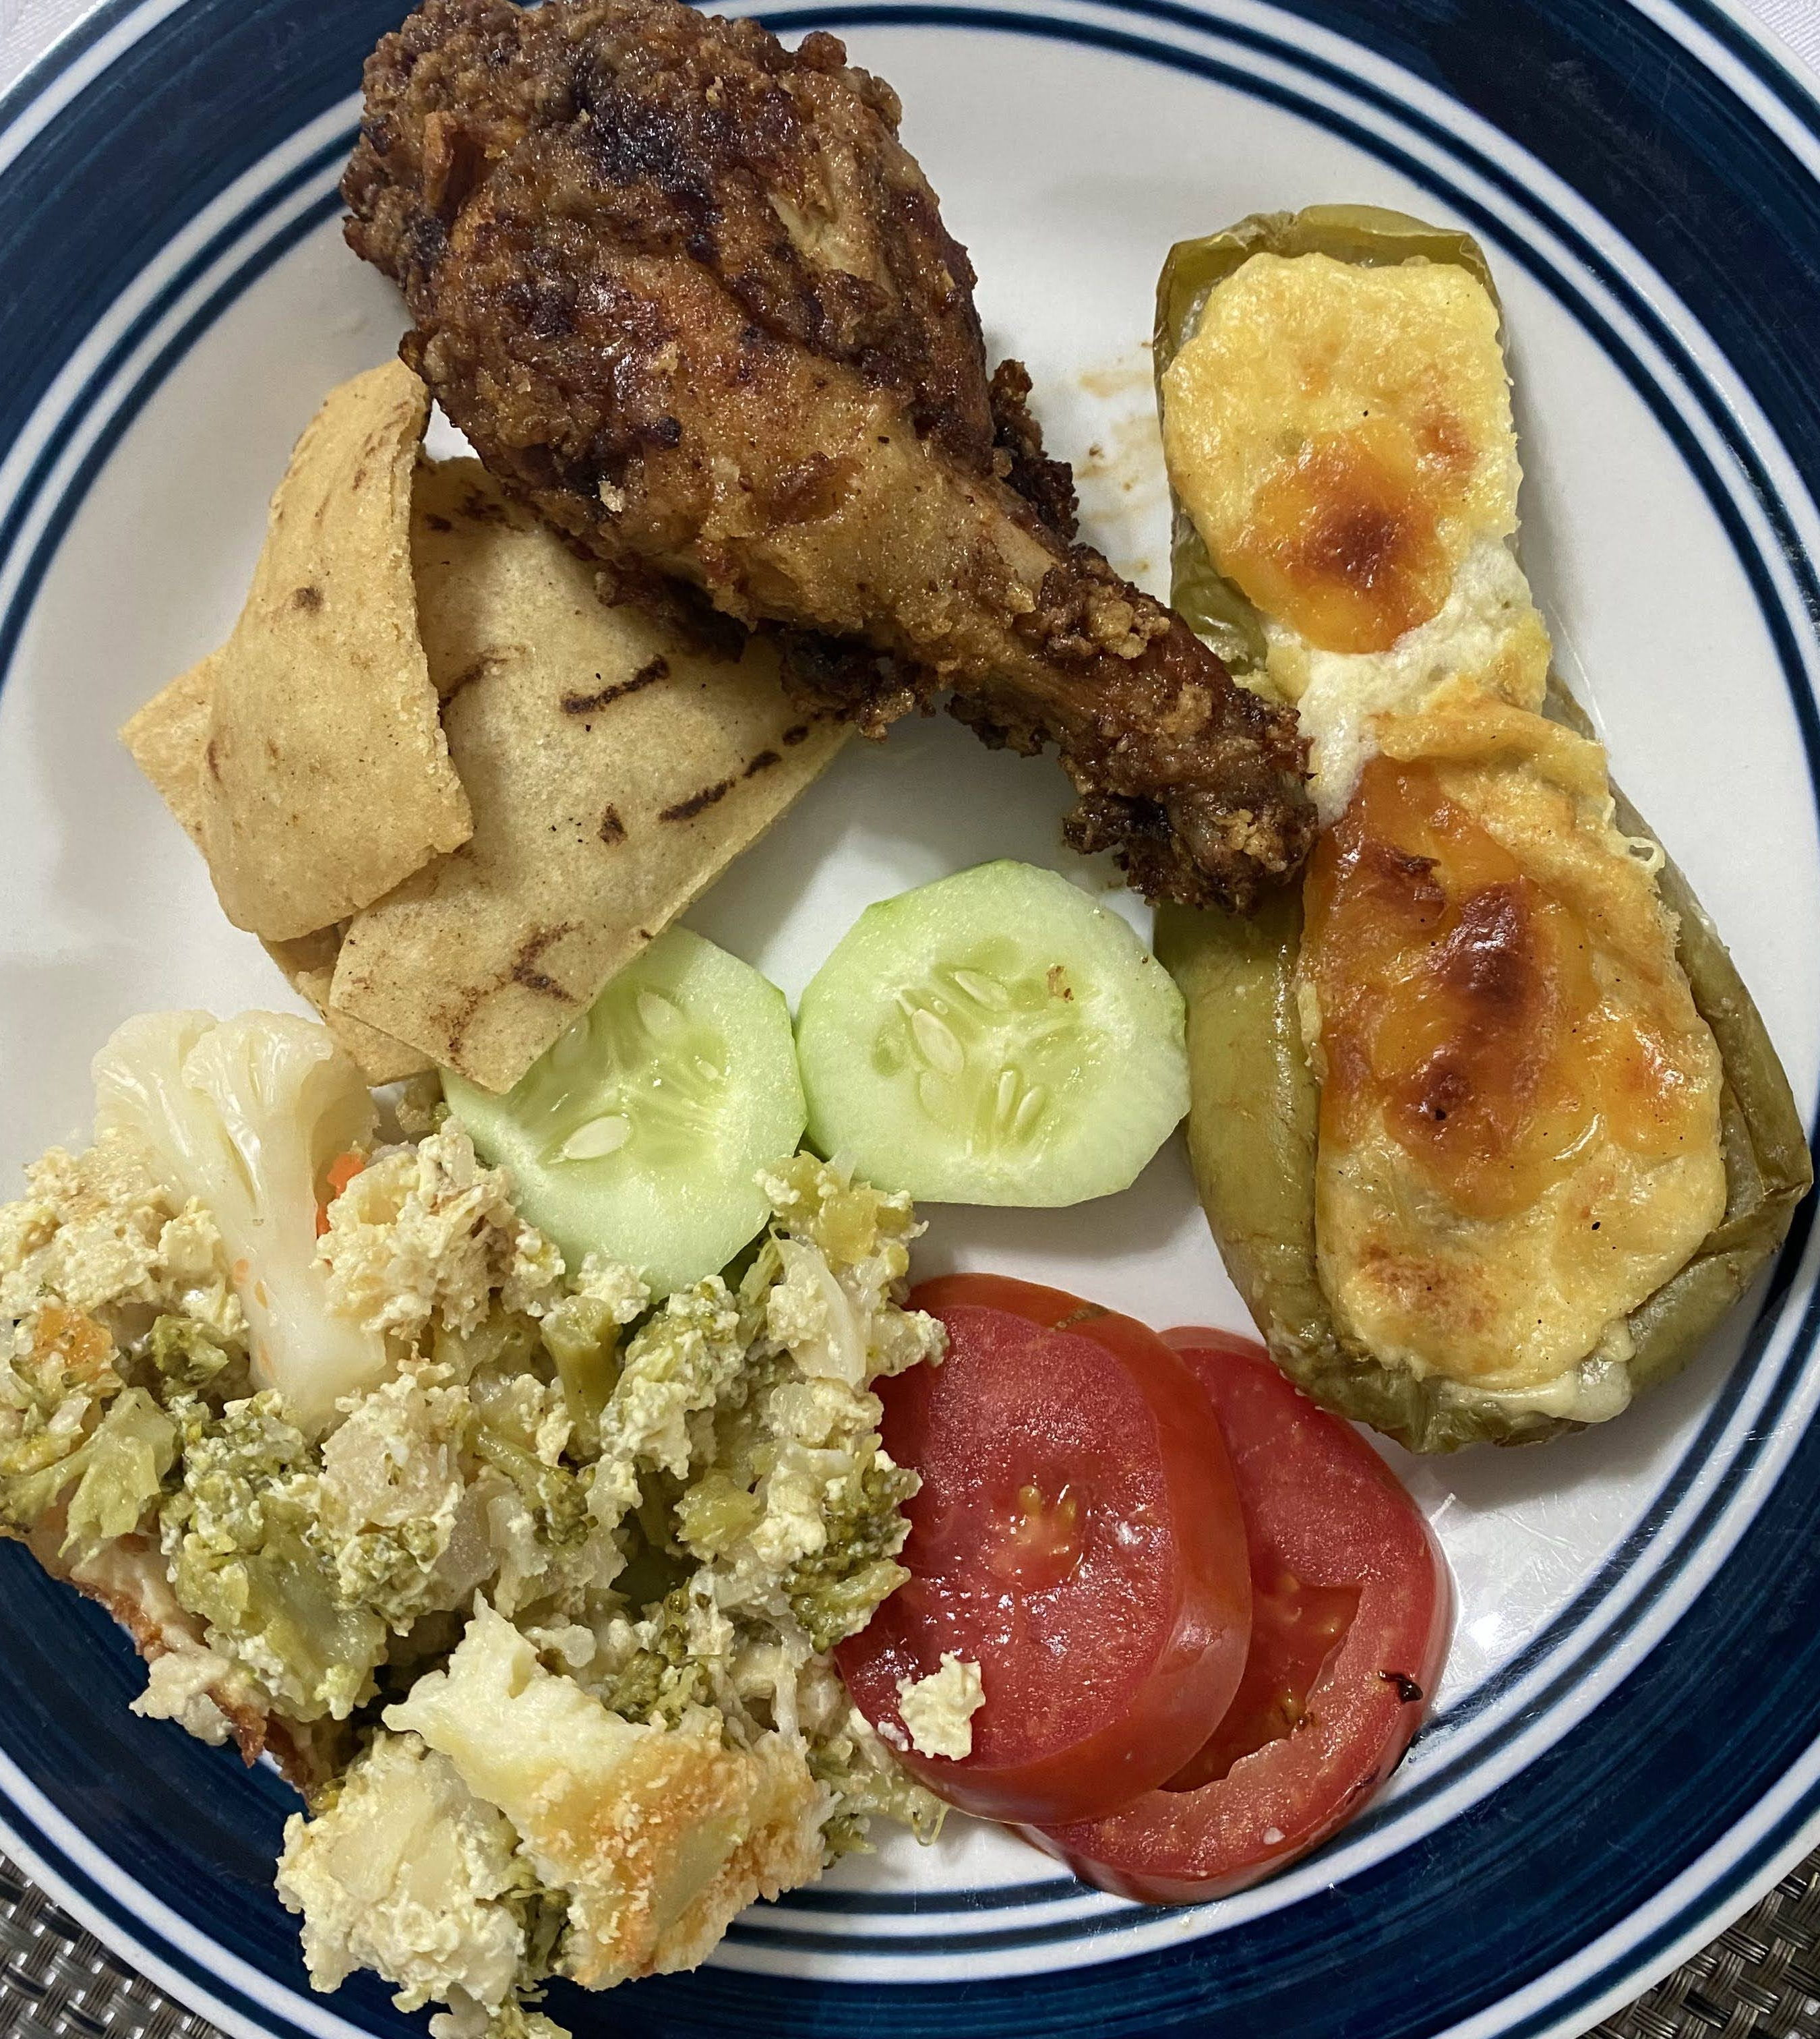
Food
Karen and Albita serve up 3 delicious meals a day for the team. This is a trip highlight for many of our volunteers. Dietary restrictions are accommodated, but please understand that vegan and vegetarian alternatives are not as common in Honduras as the US. Vegan and vegetarian meals will not include meat or dairy but may not have an alternative protein. If you would like to supplement the meals provided to you, or if you are not a fan of Honduran food, we suggest packing some non-perishable items you like with you.

Slide 5
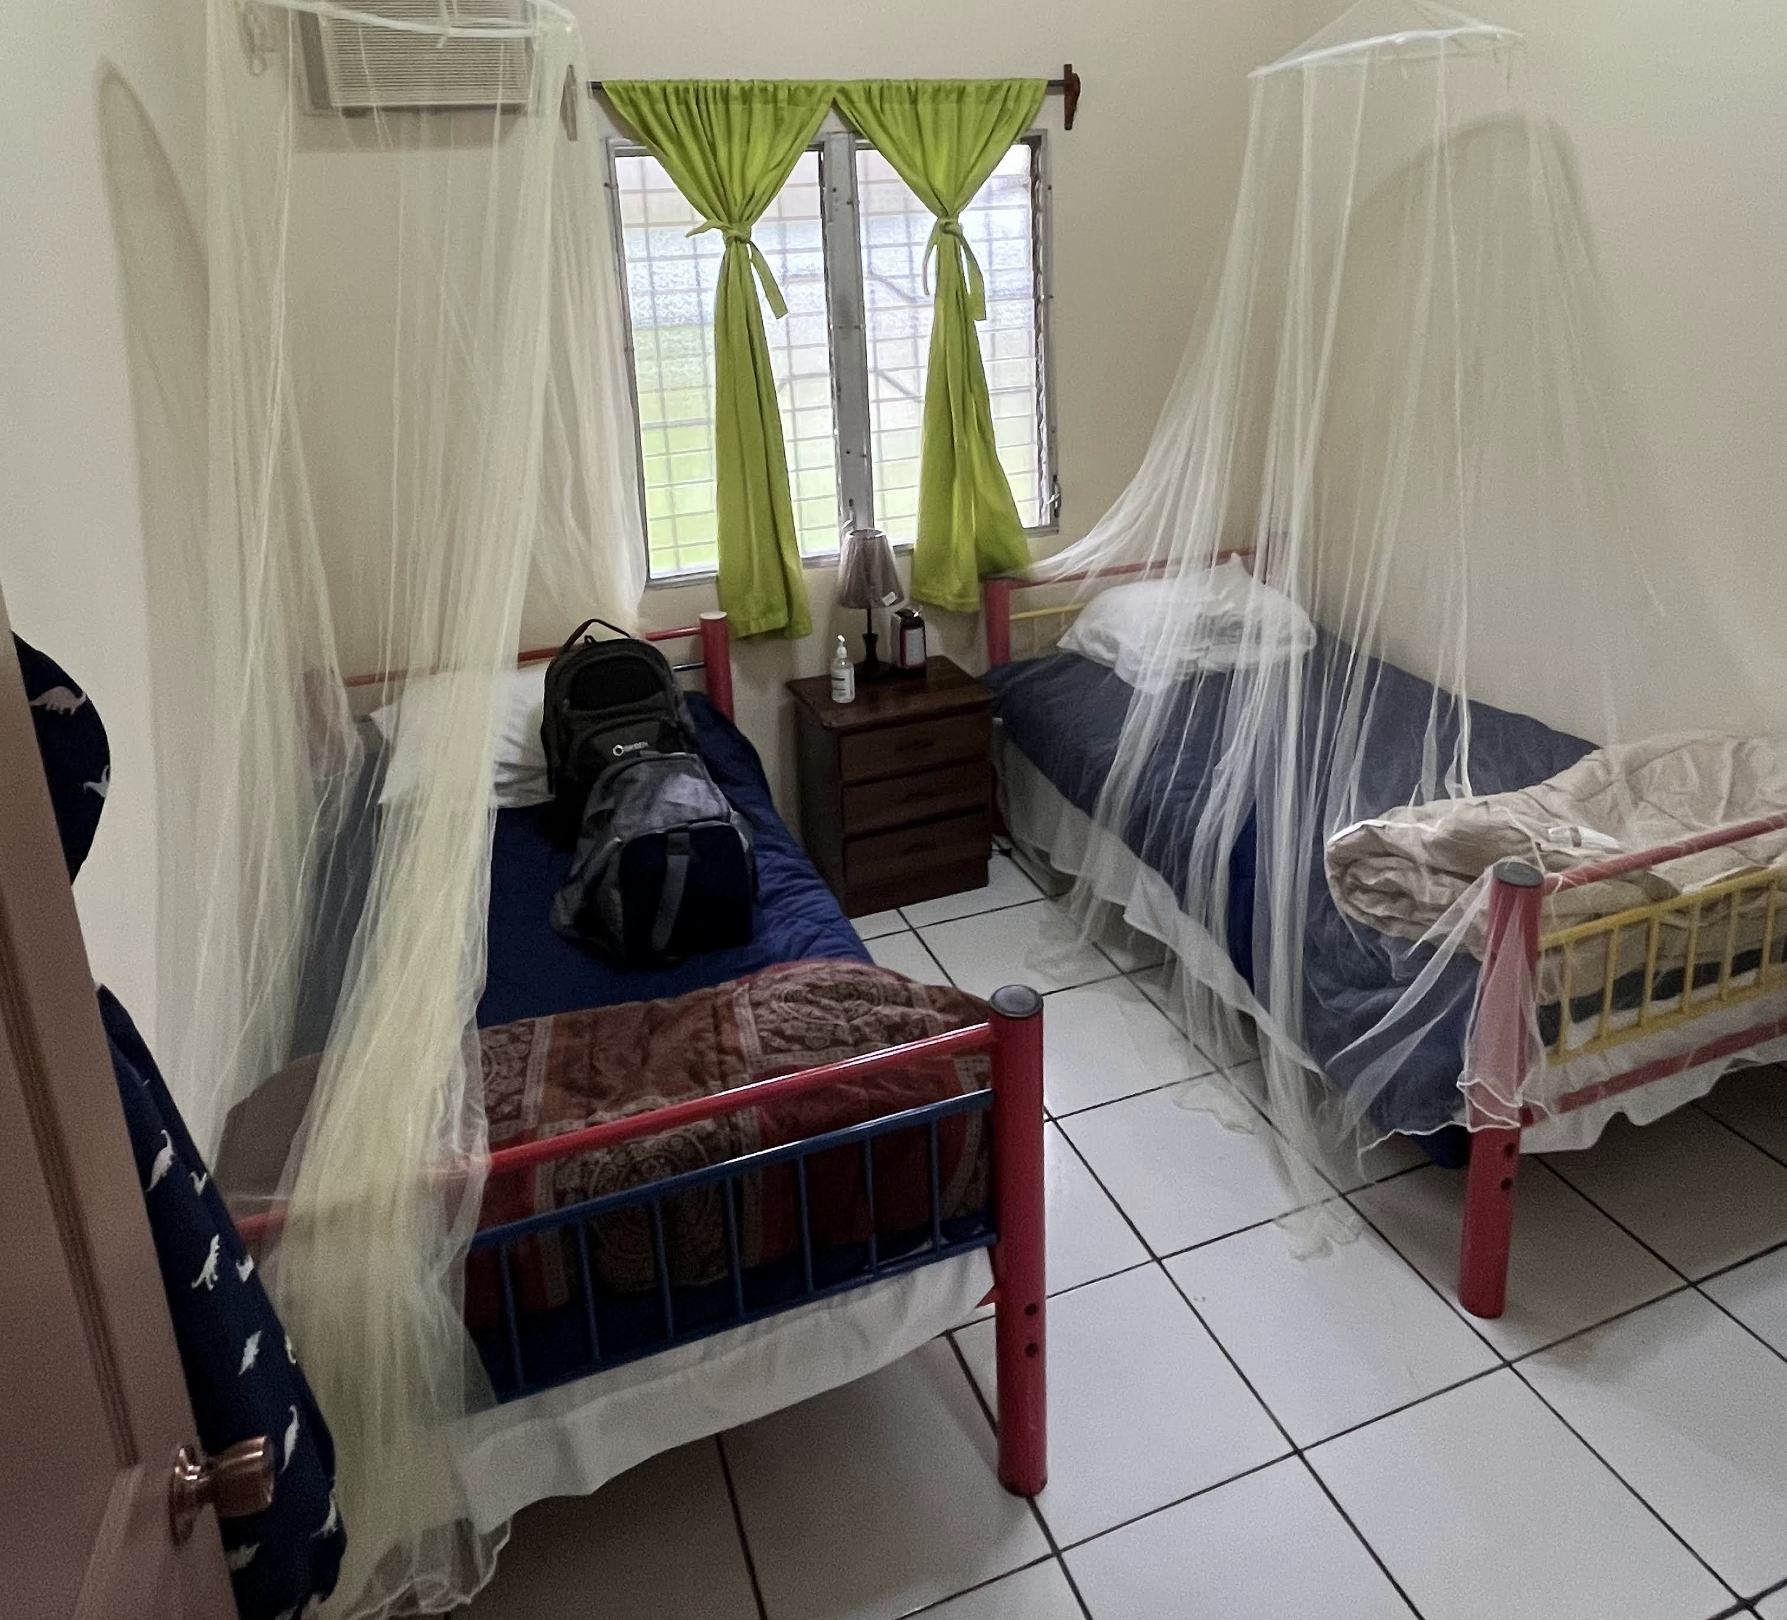
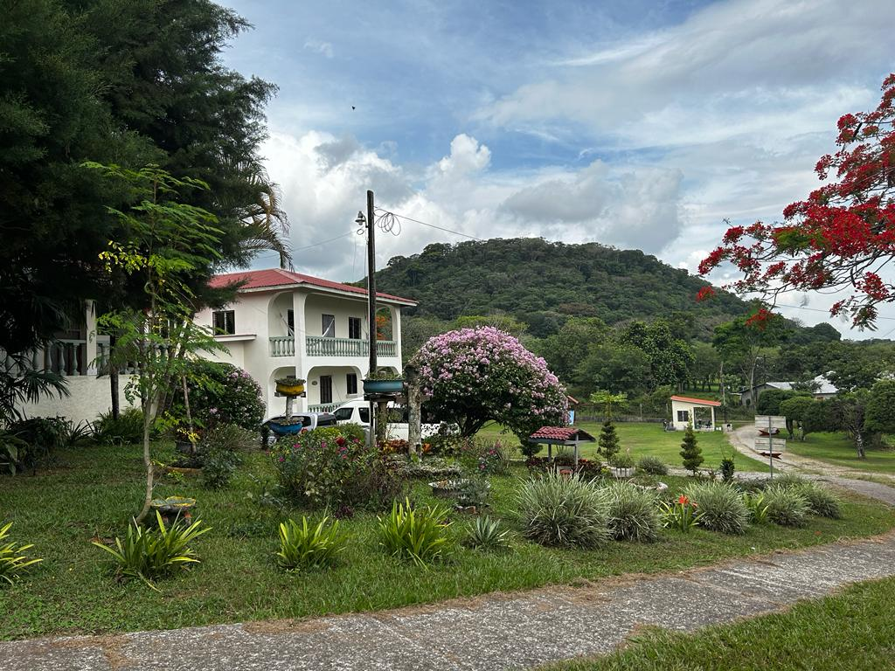
Alfredo’s House
Leave your shoes outside on the shoe rack.
Don’t flush toilet paper in any toilet in Honduras.
Sleep under the mosquito net.
The water is safe to drink at Alfredo’s House including brushing your teeth with sink faucet water.
There are 6 bedrooms, so you will have a roommate.

Slide 6
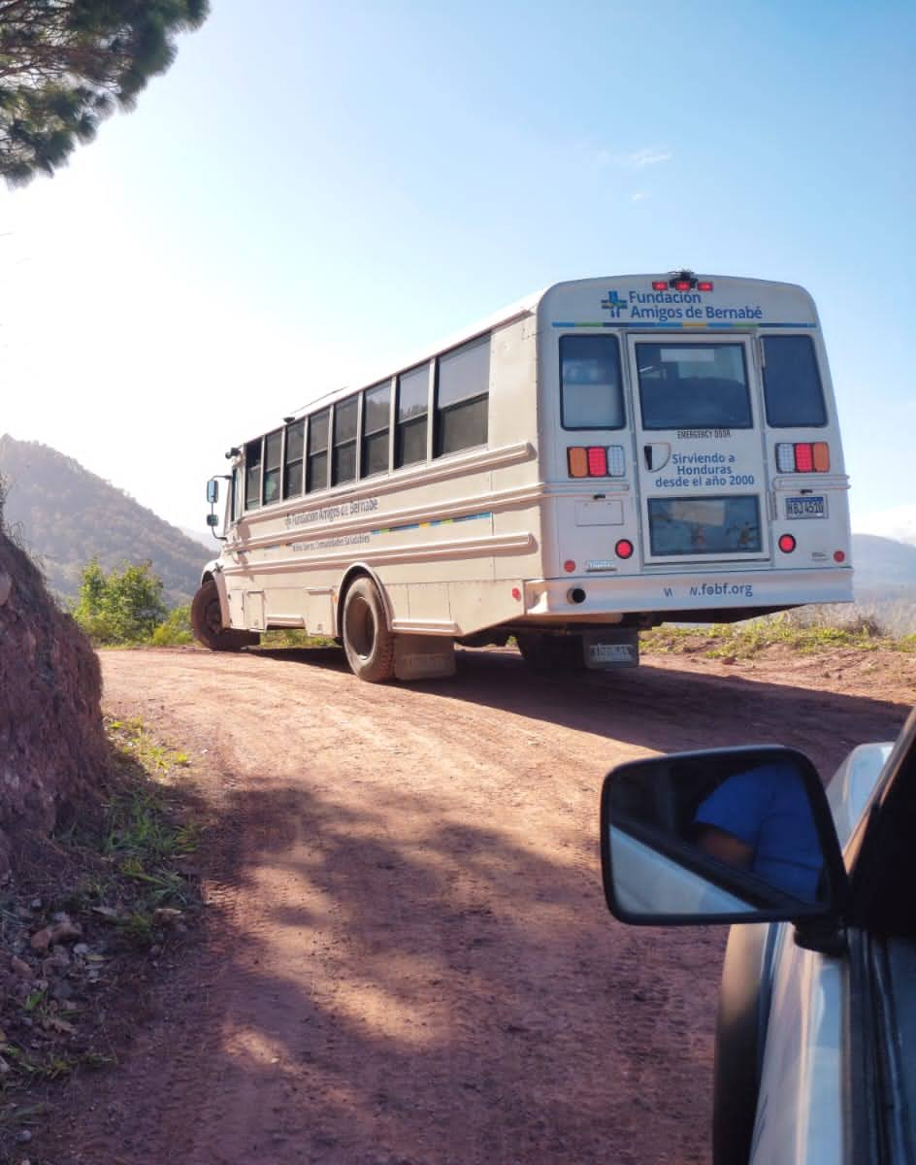
Transportation
Most of the communities we serve are 1-2 hours from Alfredo's House. There are often windy switch backs, so if you are susceptible to motion sickness you may want to take medication or wear bands to help with that.

Slide 7
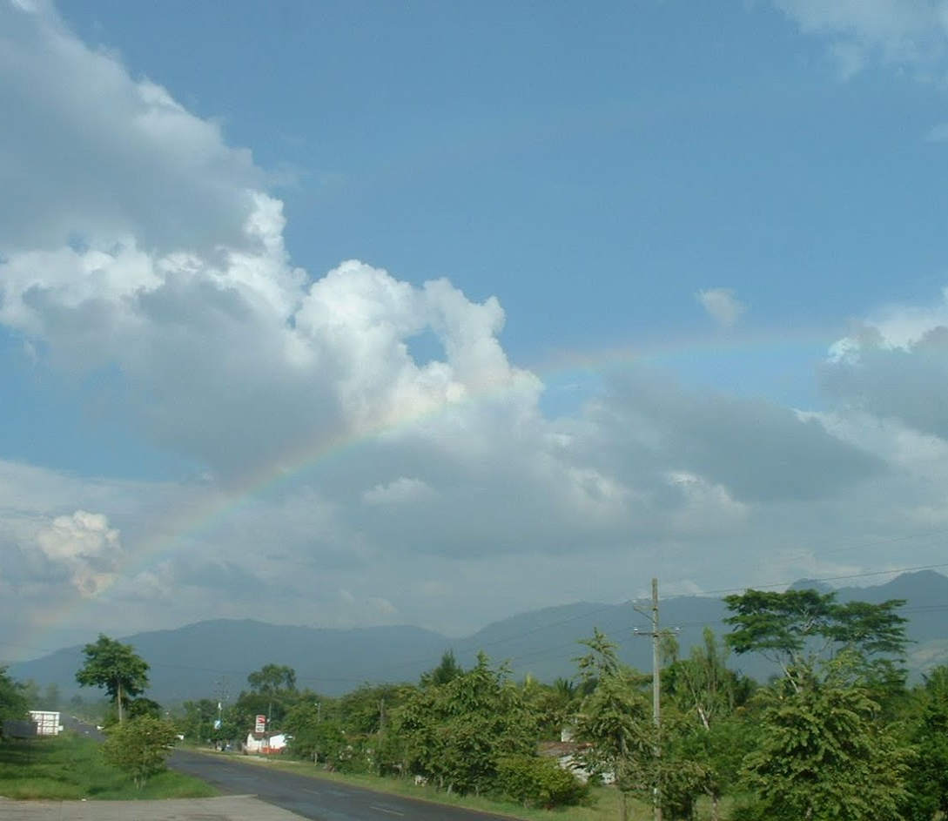
SAFETY POLICIES
Please review the Safety & Security Policies in your Team Member Handbook.
While we are often lucky to have blue skies and rainbows while in Honduras, sometimes heavy rains (or protests) can cause road closures and mean we can’t make it out to our planned community. We must always follow FOB’s instructions and be flexible to changes in our plan.
Be prepared each day with a backpack carrying essential items should you have to wait out a storm.

Slide 8
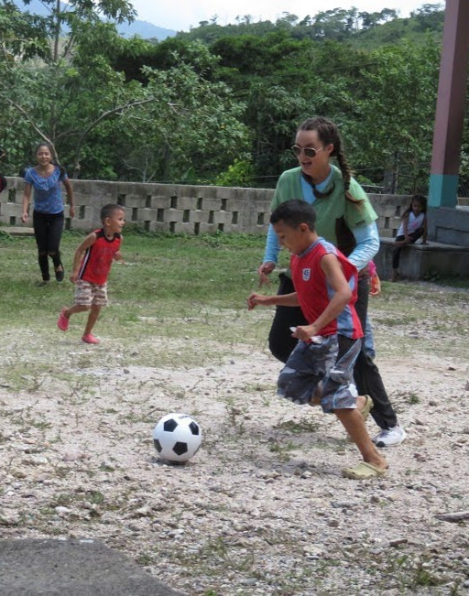
Gift Giving Policy
Here are some GUIDELINES to keep in mind:
Gifts (money, computers, shoes, clothes, toys, or anything else) are not to be given or promised either during your time in Honduras or sent later.
A request for favors from staff members (including translators) in private conversations is a serious breach of protocol and should be reported to Lidia.
Promises of future gifts are inappropriate. This includes medical equipment, procedures, or medications that a patient may need.
Asking staff members to tell you what they need is inappropriate.
Giving toys to children in the villages is inappropriate.

Slide 9
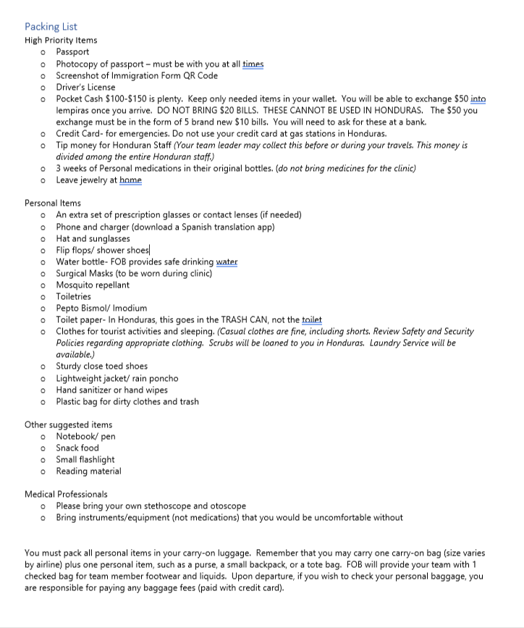
Packing List
Available in Team Member Handbook

Slide 10
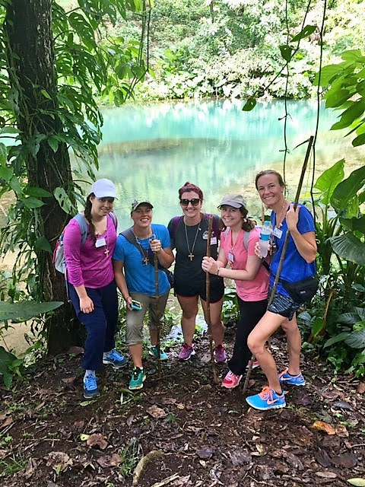
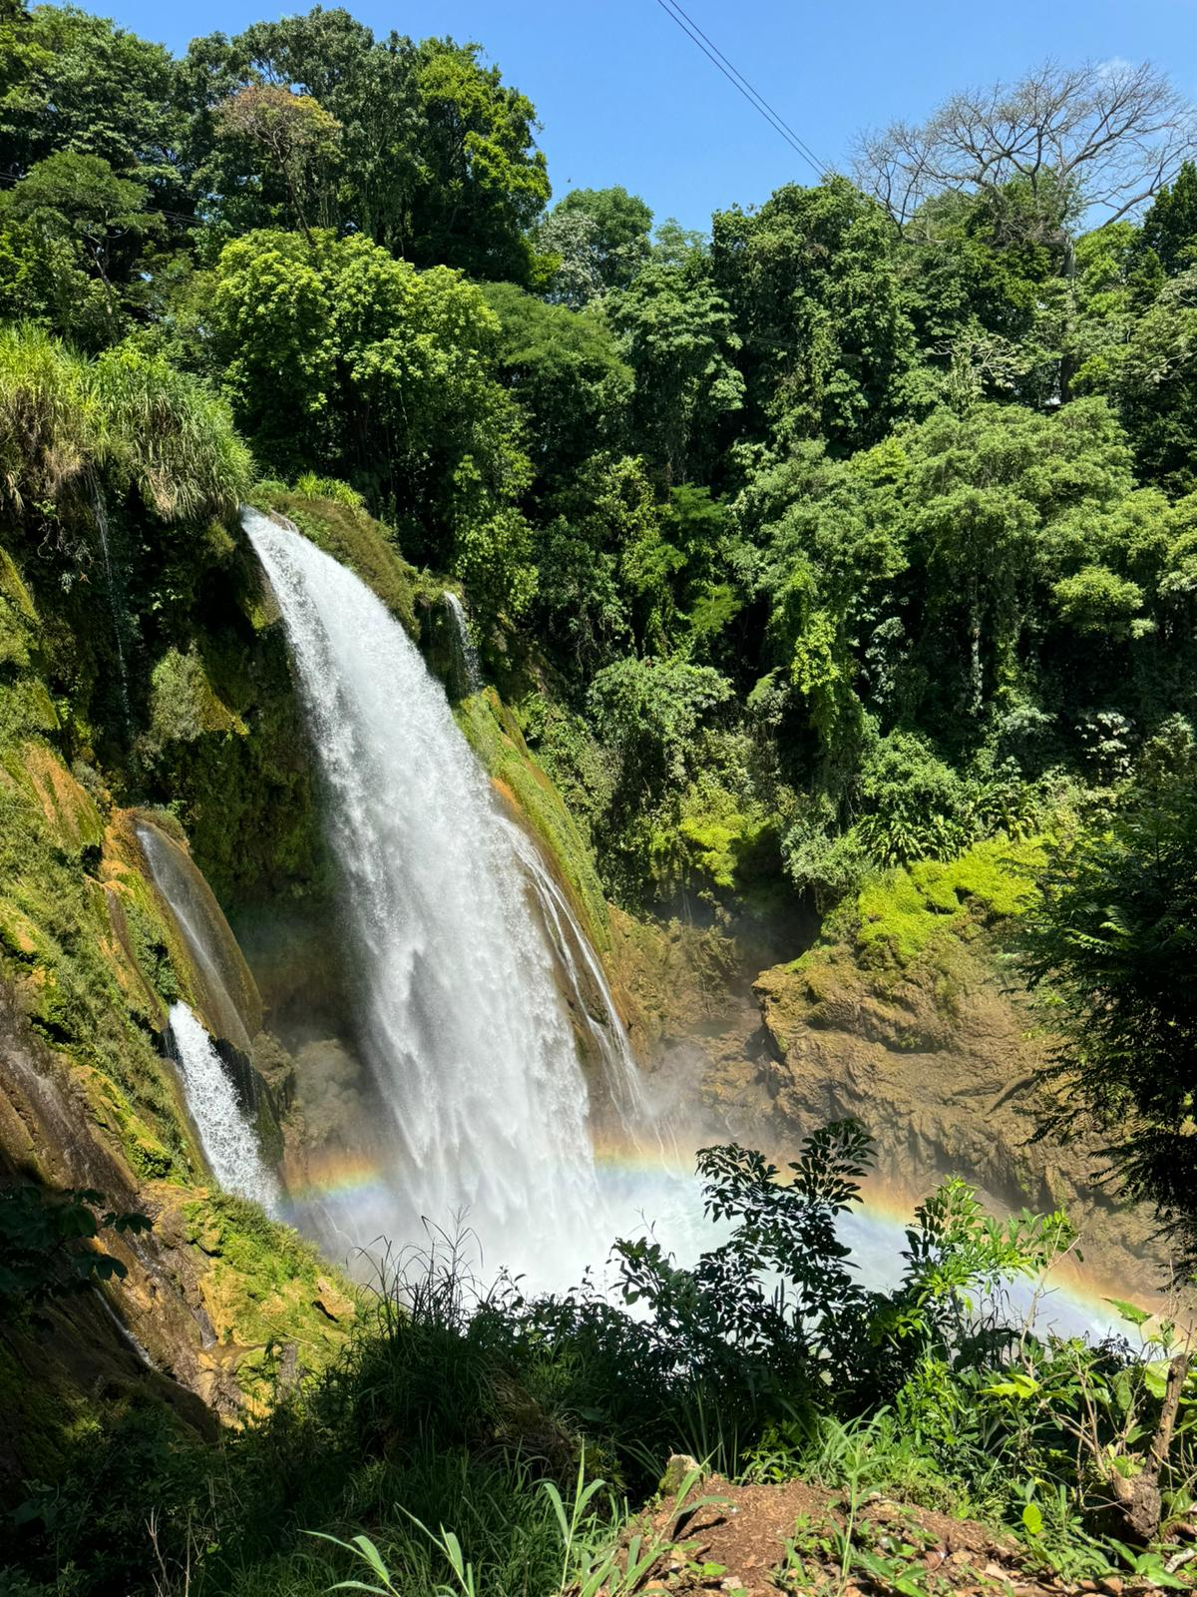
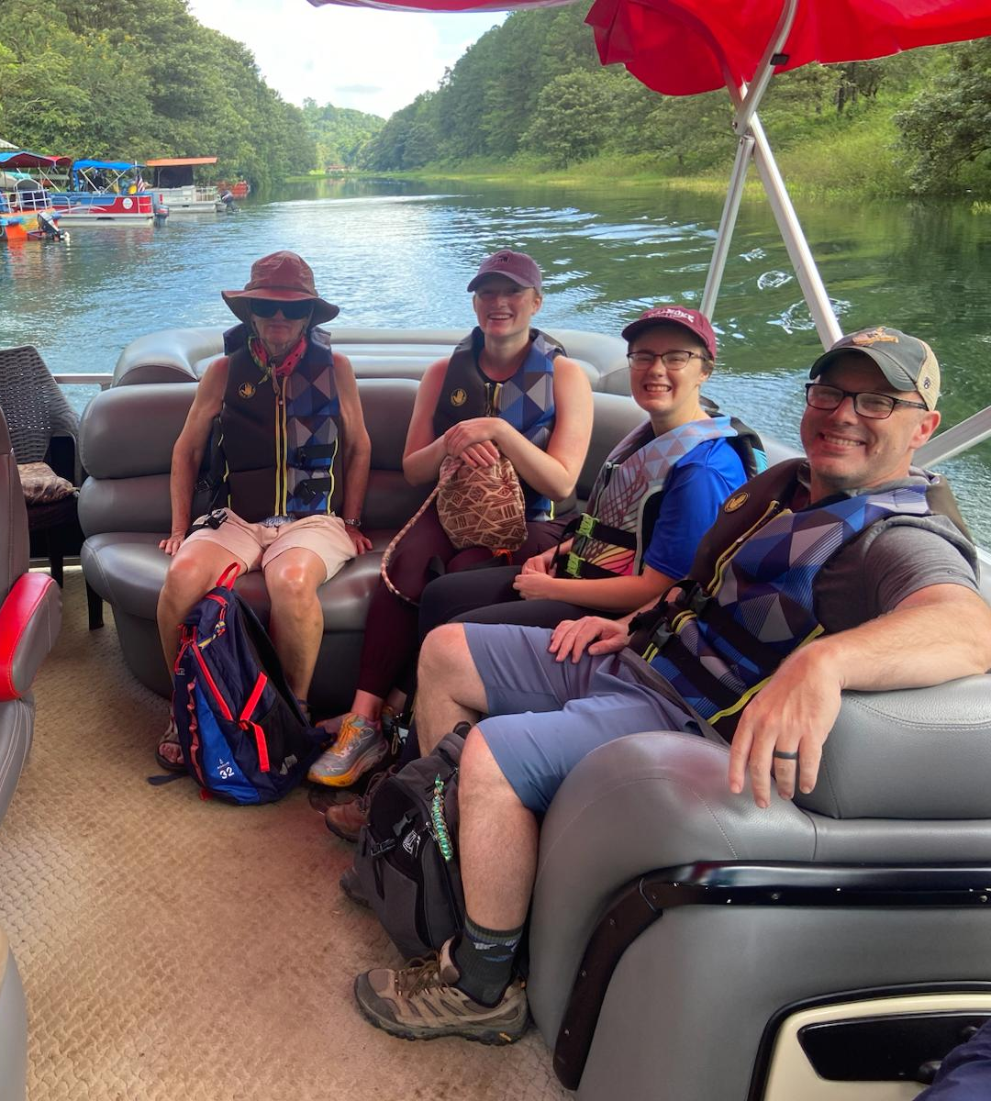
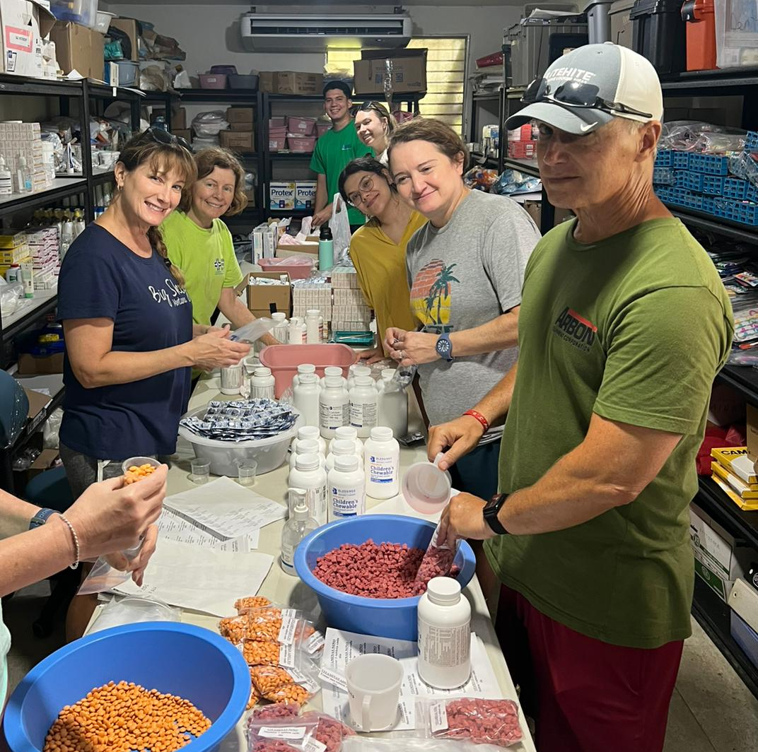
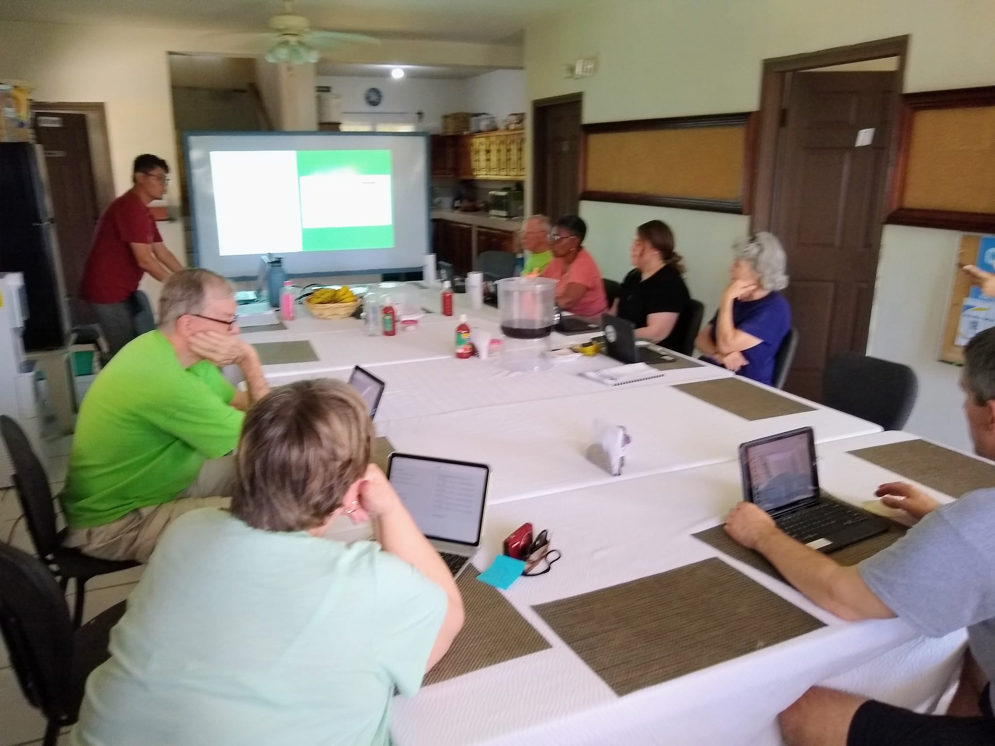
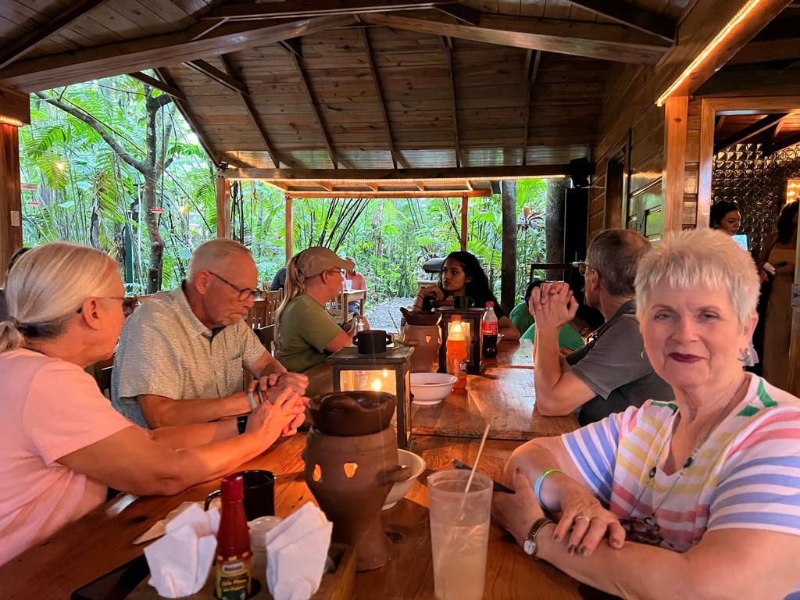
Sunday
Morning Excursion – bring Lempiras
Stop at Grocery Store – bring Lempiras
Lunch at Alfredo’s House
Pack Pills
EMR Training
Dinner at Restaurant
Botanical Gardens
Pulhapanzak
Boat Ride
L100 / $4
L100 / $4 - $25 to zipline
L100 / $4

Slide 11

Fundraising Check In
Have we reached our goal?

Slide 12
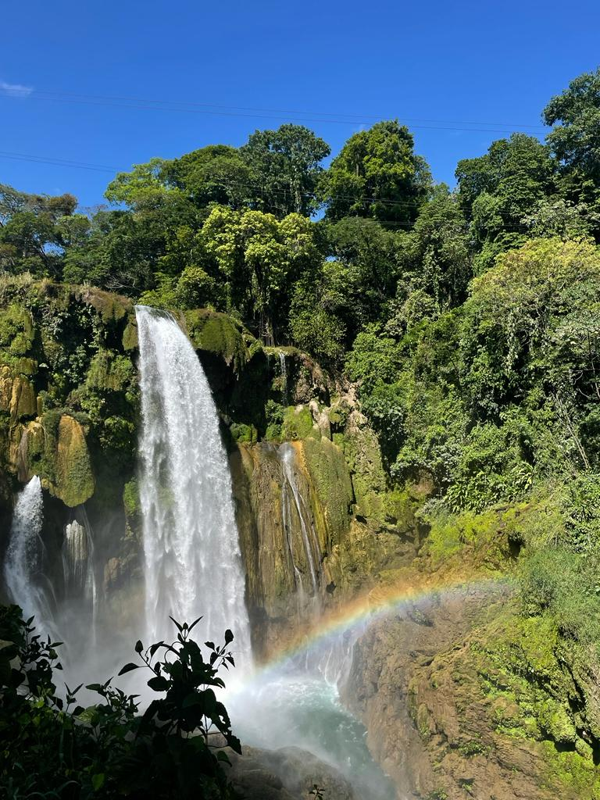
Don’t Forget….
Have you given Team Leader your notarized Medical Release Form?
Have you registered with the US Embassy? Instructions are in the Team Member Handbook.
Have you downloaded WhatsApp and joined the Team Chat?
Five crisp, clean $10 bills! We cannot exchange crumpled, torn, written on, dirty bills. No $20’s either.
The day before departure you must complete the Customs Form online. Instructions are in the Team Member Handbook and at fobf.org/resources. You need a screenshot of the QR code that pops up once you submit the form to show in customs.
WHAT QUESTIONS DO YOU HAVE??

